Slide 1
Machine Learning
Deep Neural Network

Slide 2
Deep Learning
Deep learning uses artificial neural networks to perform complex computations on large amount of data.
This is also called intensed learning
Alternative definition:
a type of machine learning based on artificial neural networks in which multiple layers of processing are used to extract progressively higher level features from data.

Slide 3
Key features
Uses artificial neural networks.
Learns from large datasets with minimal human intervention.
Excels in complex tasks like image recognition, speech processing, and natural language understanding.

Slide 4
Deep learning applications
Self Driving Cars.
News Aggregation and Fraud News Detection.
Natural Language Processing.
Virtual Assistants.
Entertainment.
Visual Recognition.
Fraud Detection.
Healthcare.

Slide 5
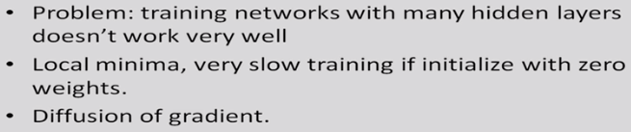
Deep neural network
Dr. Sudeshna Sarkar, IIT Kharagpur

Slide 6
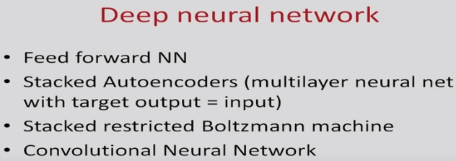
Dr. Sudeshna Sarkar, IIT Kharagpur

Slide 7
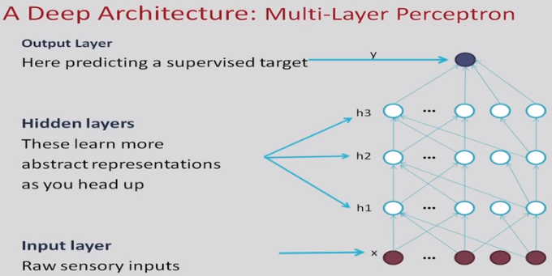
Dr. Sudeshna Sarkar, IIT Kharagpur

Slide 8
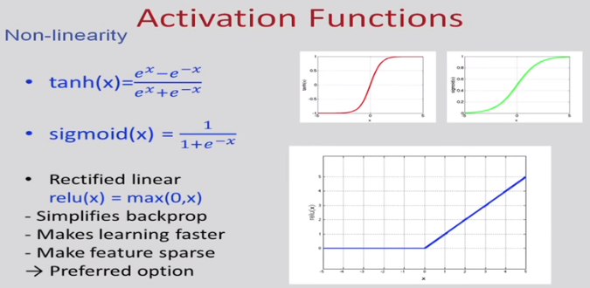
Dr. Sudeshna Sarkar, IIT Kharagpur

Slide 9
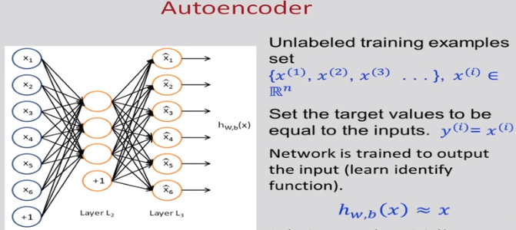
Dr. Sudeshna Sarkar, IIT Kharagpur

Slide 10
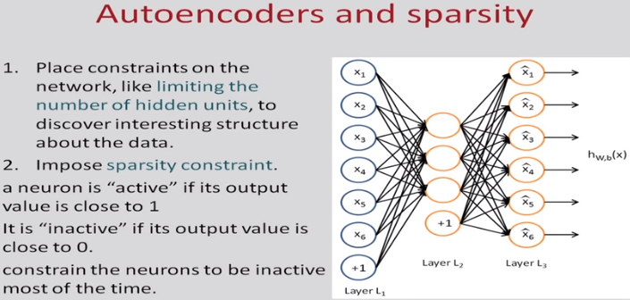
Dr. Sudeshna Sarkar, IIT Kharagpur

Slide 11
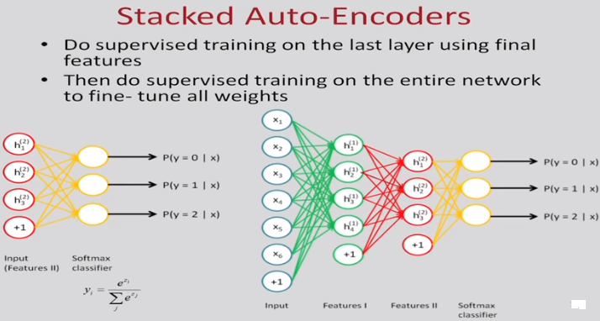
Dr. Sudeshna Sarkar, IIT Kharagpur

Slide 12
What are RNNs?
The idea behind RNNs is to make use of sequential information.
In a traditional neural network we assume that all inputs (and outputs) are independent of each other.
If you want to predict the next word in a sentence you better know which words came before it. RNNs are called recurrent because they perform the same task for every element of a sequence, with the output being depended on the previous computations.
Another way to think about RNNs is that they have a “memory” which captures information about what has been calculated so far.
In theory RNNs can make use of information in arbitrarily long sequences, but in practice they are limited to looking back only a few steps .
wildml.com

Slide 13
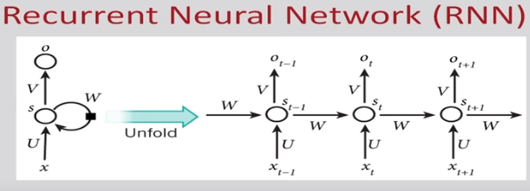
Dr. Sudeshna Sarkar, IIT Kharagpur

Slide 14
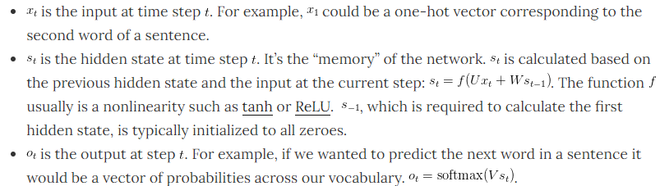
wildml.com

Slide 15
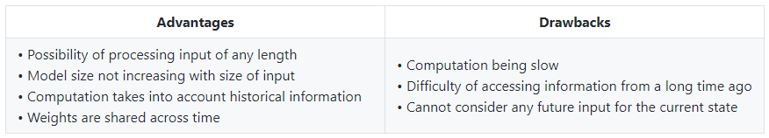
Advantages and Drawbacks
standford.edu

Slide 16
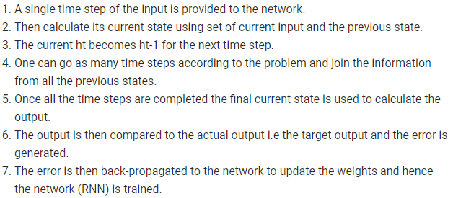
Training through RNN

